Slide 1
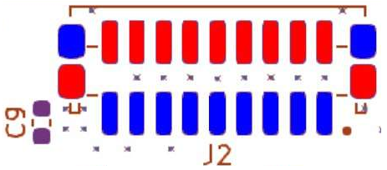
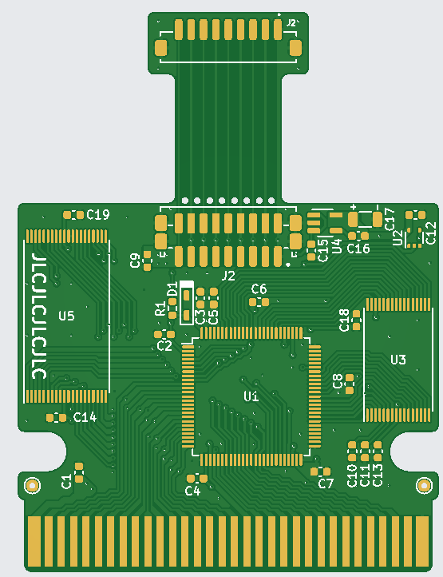
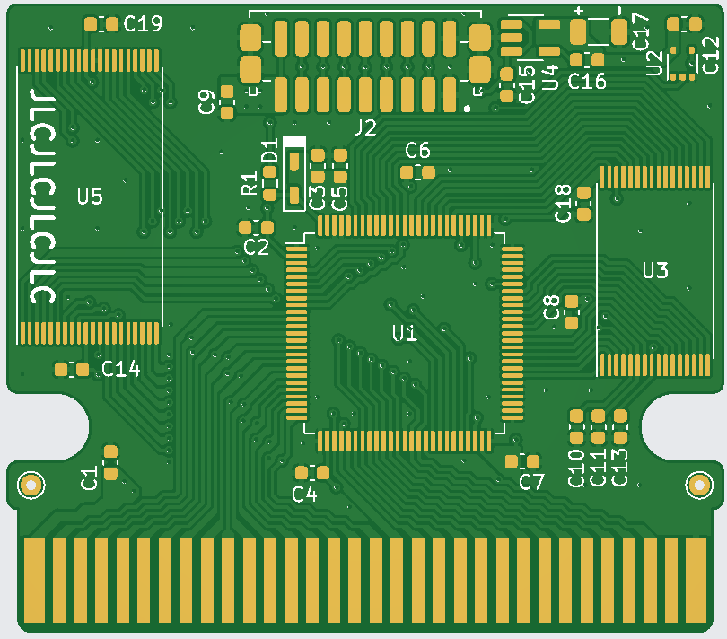
Footprint for vertical JST connector
Vertical connector only
Footprint for horizontal JST connector
Breaking area
Short PCB
Long PCB

Slide 2
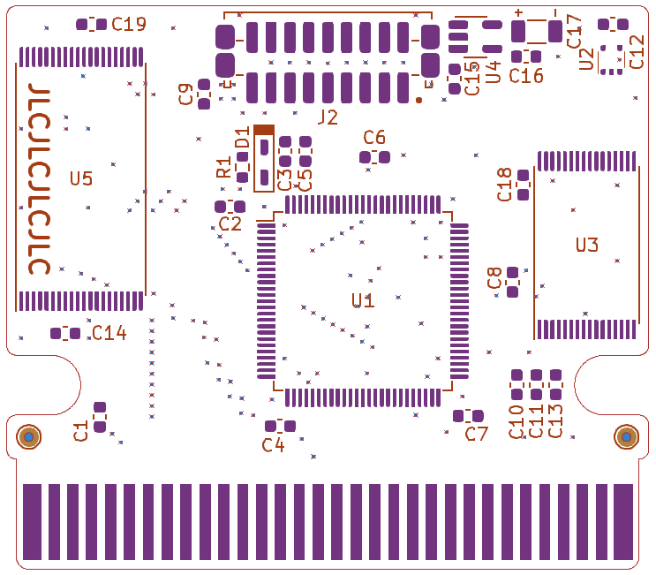
Regulator
Inverter
cathode
AM29F080B
Text orientation must coincide
anode
39 pF
MAC-GBD
Nintendo
FM28V100
Text orientation must coincide
10 nF
dot
100 nF
dot
notch
22 µF
1 kΩ
Text orientation must coincide
chips
dot

Slide 3
Regulator
C12 unpopulated
Wire or 1kΩ
cathode
AM29F080B
Text orientation must coincide
anode
MAC-GBD
Nintendo
FM28V100
39 pF
Text orientation must coincide
100 nF
dot
22 µF
dot
notch
1 kΩ
Text orientation must coincide
chips
dot

Slide 4
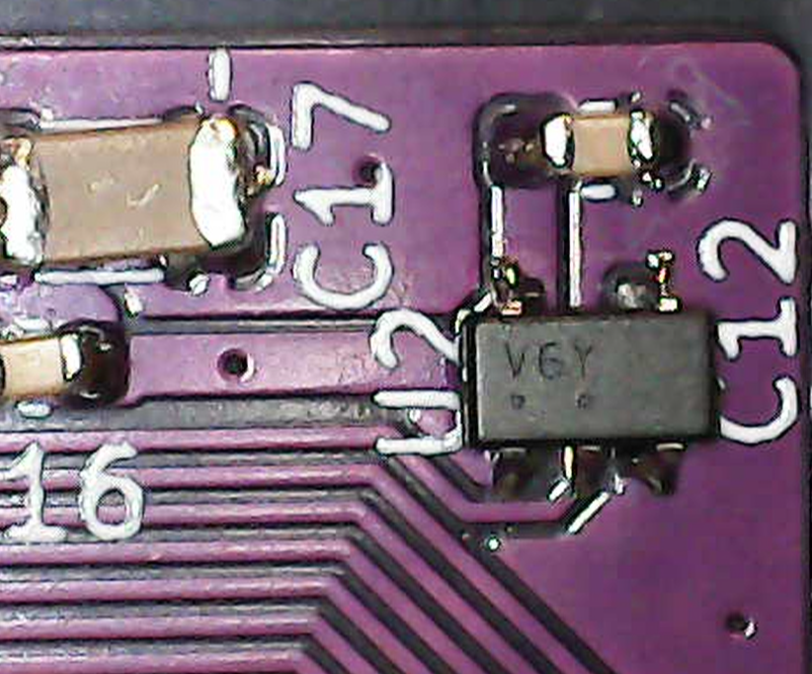
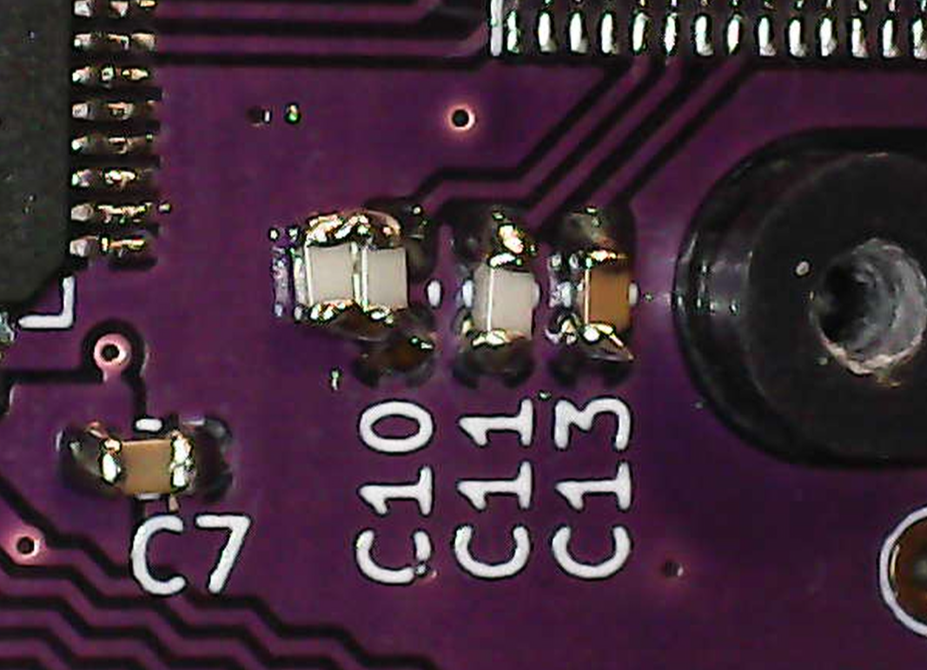
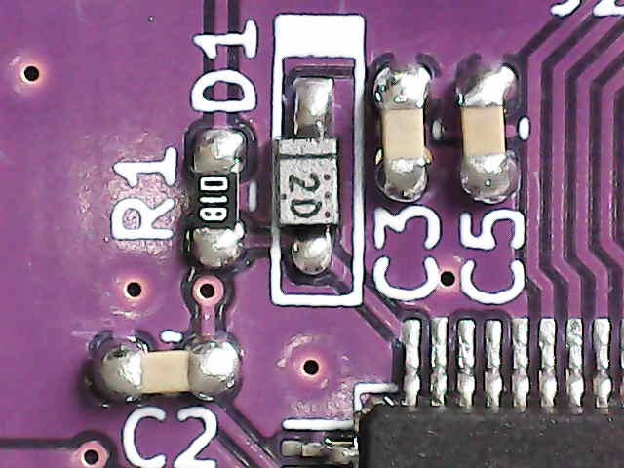
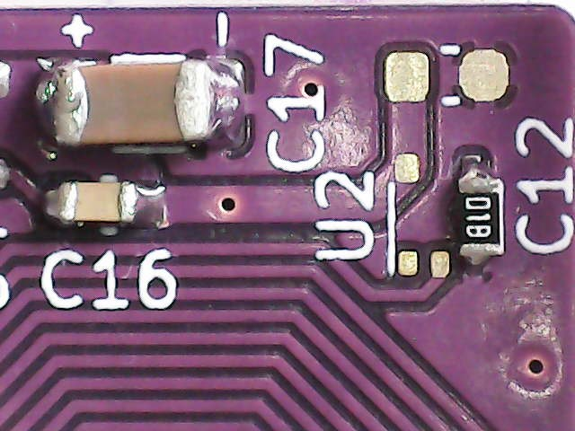

Slide 5
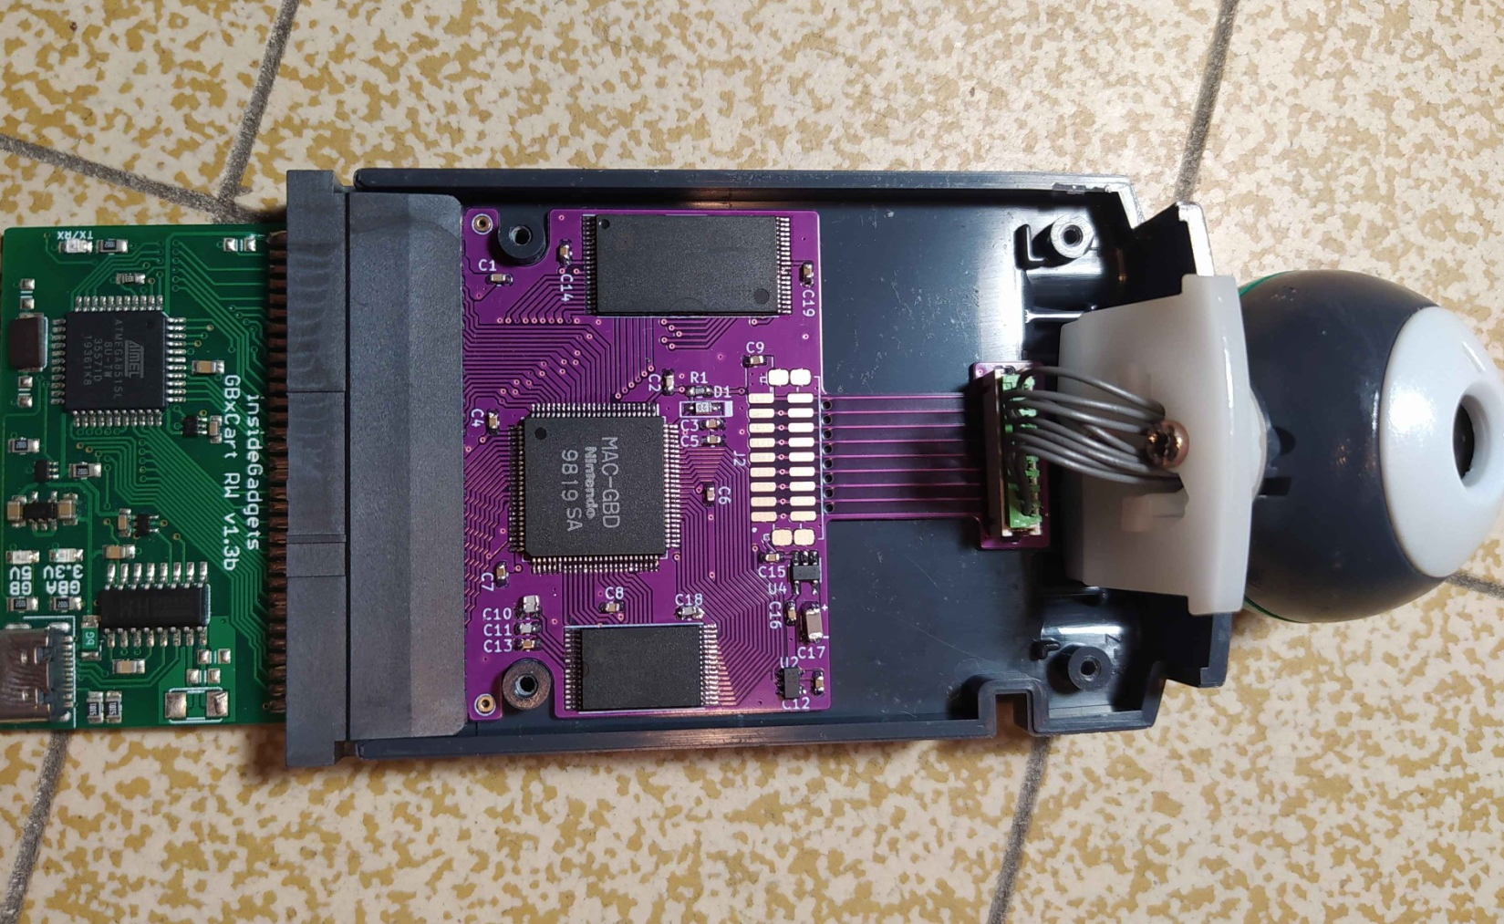

Slide 6
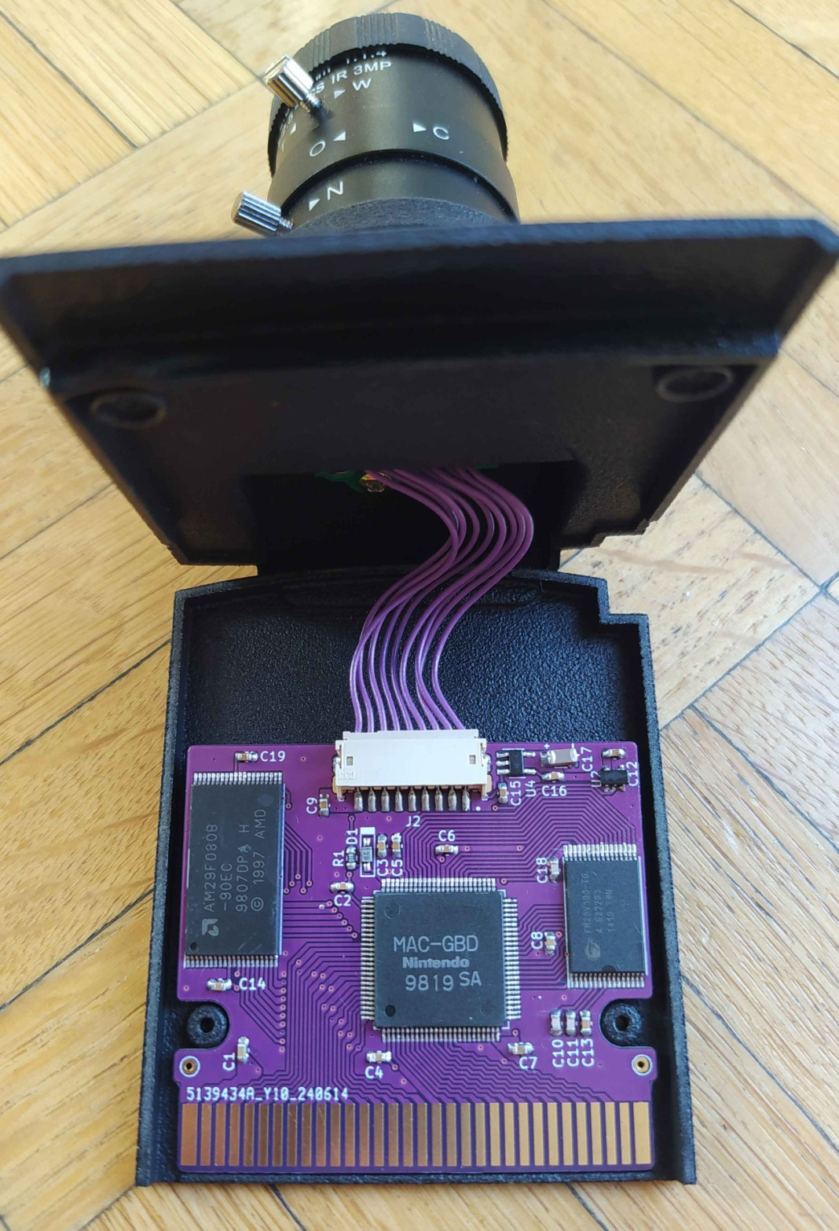
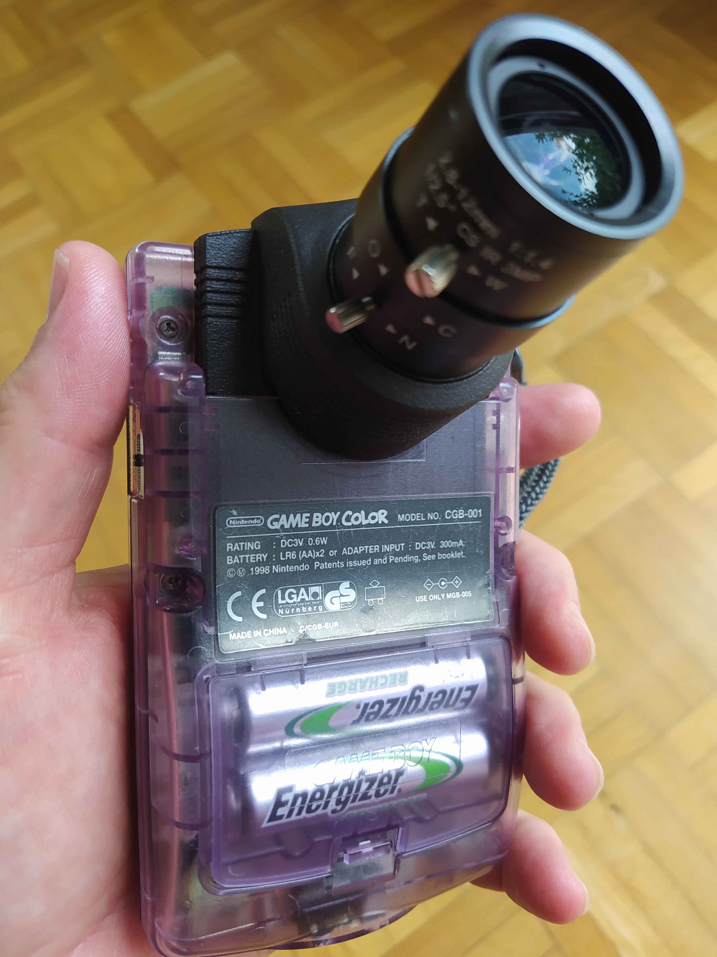

Slide 7


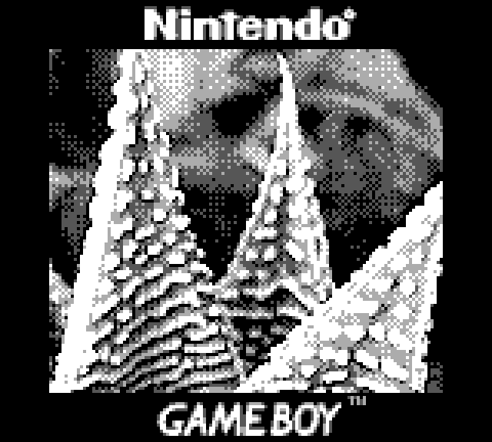

Slide 8
